Slide 1
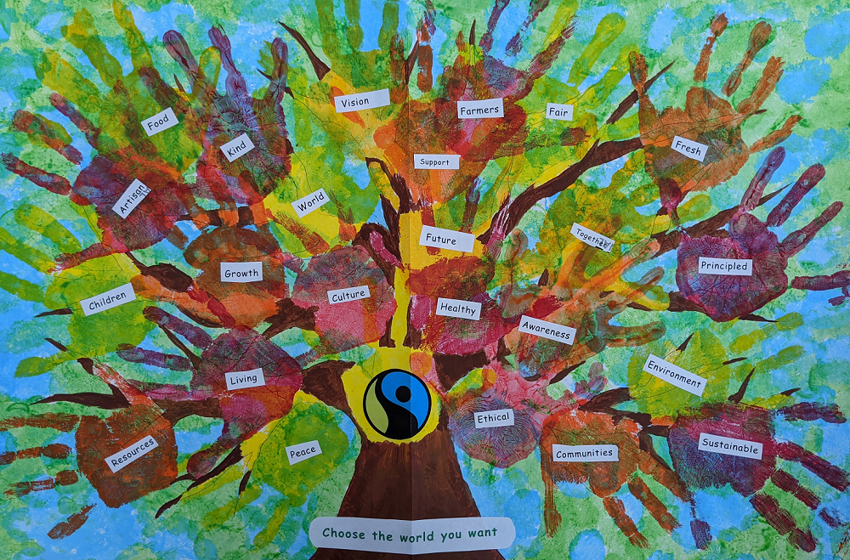
This Fairtrade Fortnight, we invite you to stand with farmers and workers seeking climate justice. We would like you to write down on a hand template, what you would like the world to be like in the future. These will then be displayed in school.
It could be..
I hope for a brighter future
World peace
Everyone to be kind to others
Sustainable world
Healthy
Equal rights for everyone
Everyone to be happy

